Slide 1
Cosmology—The Beginning and the End
Evidence of the Big Bang
The Big Bang
Stellar Evolution
Astronomical Objects
Problems with the Big Bang
The Age of the Universe
The Future
I too can see the stars on a desert night, and feel them. But do I see less or more? The vastness of the heavens stretched my imagination—stuck on this carousel my little eye can catch one-million-year-old light.
- Richard Feynman

Slide 2
16.1: Evidence of the Big Bang
Big Bang theory: universe created from dense primeval fireball.
Steady state theory: matter continuously created with net constant density.
Evidence for Big Bang theory:
  Hubble observed that the galaxies of the universe are moving away from each other at high speeds. The universe is apparently expanding from some primordial event.
  Penzias and Wilson observe that a cosmic microwave background radiation permeates the universe.
  The predictions of the primordial nucleosynthesis of the elements agree with the known abundance of elements in the universe.

Slide 3
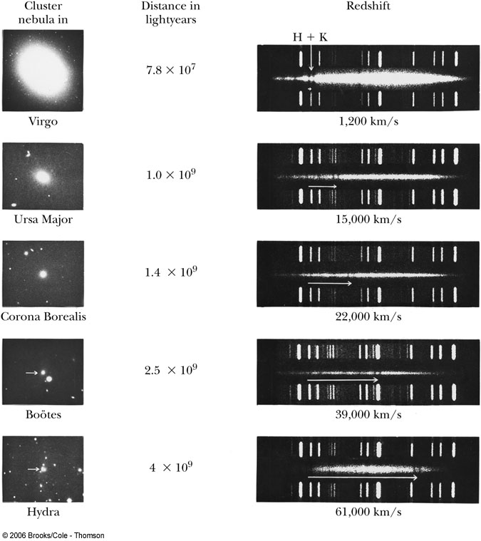

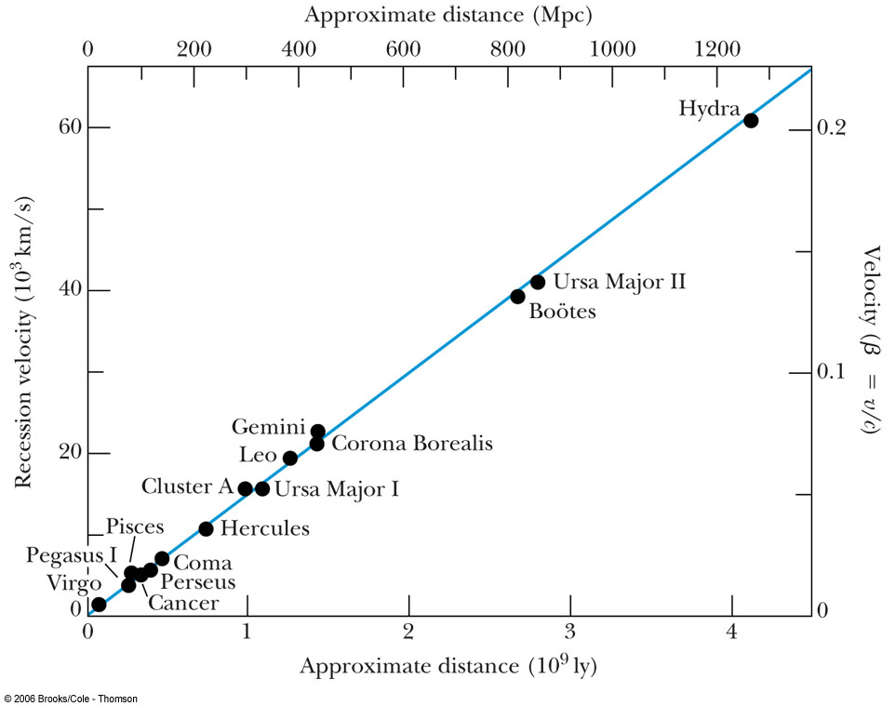
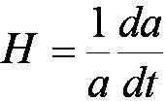
Hubble’s Measurements
The recessional velocity of astronomical objects is inferred from the shift toward lower frequencies (redshift) of certain spectral lines emitted by very distant objects.
Hubble’s law: v = HR
H is called Hubble’s parameter and it is related to a scale factor a that is proportional to the distance between galaxies:
The value today is known as Hubble’s constant.

Slide 4

Universal Expansion
It is not necessary for Earth to be at the center of the universe to observe the expansion.

Slide 5
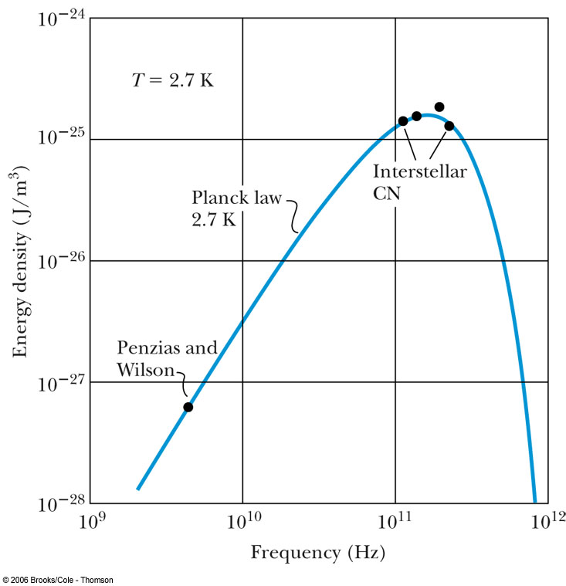
Cosmic Microwave Background Radiation
Because of the rapid expansion and cooling of the early universe, matter had decoupled from radiation at a temperature of 3000 K.
That blackbody radiation characteristic of 3000 K several billion years ago has Doppler-shifted to 3 K today.
Satellite measurements show a nearly isotropic 3 K radiation background.

Slide 6
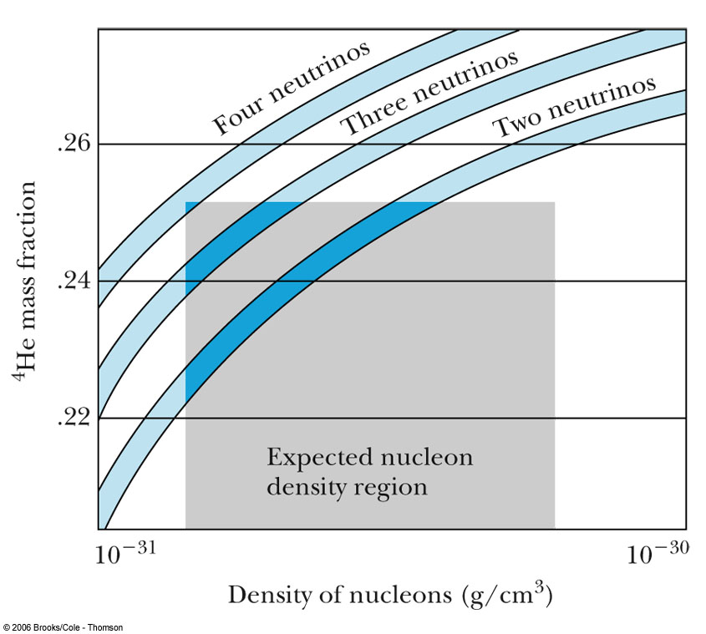
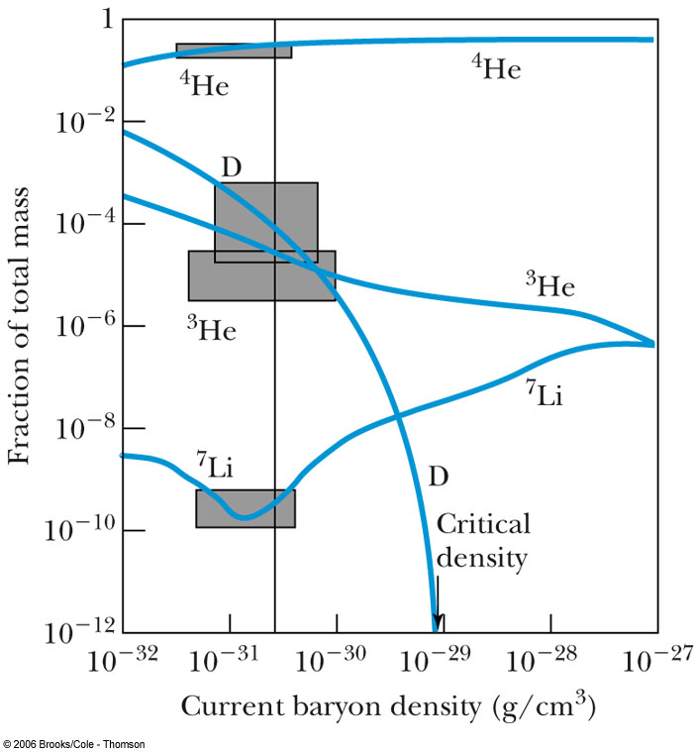
Nucleosynthesis
By measuring the present relative abundances of the elements, physicists are able to work backward and test the conditions of the universe that may have existed when neutrons and protons were first joined to produce nuclei.
Heavier elements are formed in stars but the vast majority of the known mass in the universe is composed of hydrogen and helium.

Slide 7
16.2: The Big Bang
The Big Bang model rests on two theoretical foundations:
  The general theory of relativity
  The cosmological principle, which assumes the universe looks roughly the same everywhere and in every direction. The universe is both isotropic and homogeneous.
Alexander Friedmann showed the universe originated in a hot explosion called the Big Bang.
Robertson–Walker metric is the simplest spacetime geometry consistent with an isotropic, homogeneous universe.

Slide 8
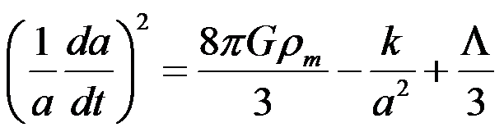
The Big Bang
One of the Friedmann cosmological equations can be written
The last term contains the cosmological constant, which was introduced by Einstein to form a static universe because astronomers assured him of a static universe.
The cosmological constant term accounts for the energy of a perfect vacuum in order to have an isotropic and homogeneous universe.
After Hubble’s discovery of the expanding universe, the cosmological constant was set to zero.

Slide 9
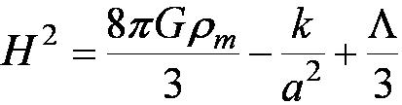
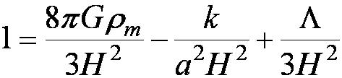
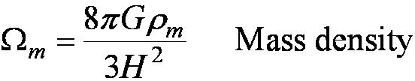
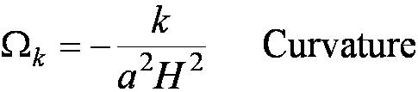
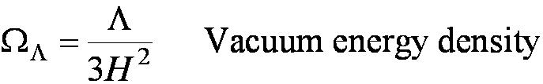
The Big Bang
We can rewrite this equation using the Hubble parameter H. This is called the Friedmann Equation.
Dividing both sides by the left side yields:
Each of the terms in this equation has special significance in cosmology.

Slide 10
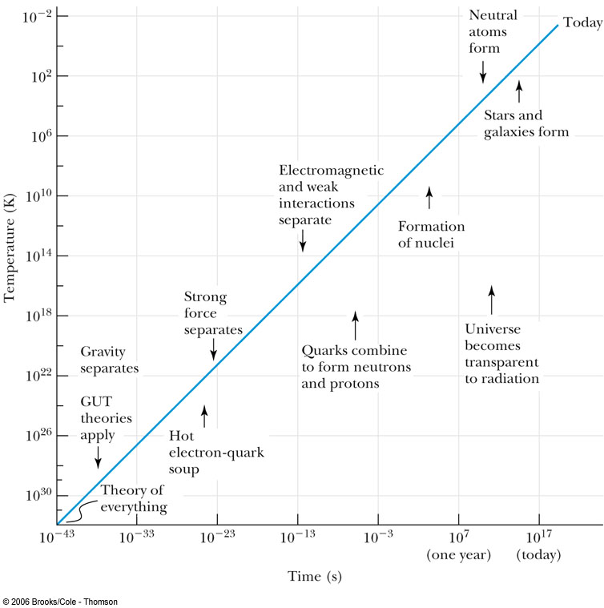
The Unknown
During the first 10⁻⁴³ seconds after the Big Bang we have no theories because the known laws of physics do not apply.
In the beginning the universe most likely had infinite mass density and zero spacetime curvature.
The size of the universe by the time 10⁻⁴³ was probably less than 10⁻⁵² meters.
The four fundamental forces of strong, electromagnetic, weak, and gravity were all unified into one force.
The temperature was probably 10³⁰ K.

Slide 11
The Big Bang
Gravity Separates
During the time 10⁻⁴³ s to 10⁻³⁵ s the universe expanded to the size of 10⁻³⁰ m.
The temperature was 10²⁸ K.
Gravity separated as the first distinct force.
Quark-Electron Soup
During 10⁻³⁵ s - 10⁻¹³ s the strong force had separated.
Quarks and leptons had formed as well as their antiparticles. The universe at this moment was a hot soup of electrons and quarks.
The temperature was 10¹⁶ K and the size was 10⁻¹ m.

Slide 12
The Big Bang
Neutrons and Protons Form
During 10⁻¹³ s - 10⁻³ s the quarks bound together to form neutrons and protons.
The temperature was 10¹⁵ K.
Electromagnetic and Weak Forces Separate
The electromagnetic and weak interactions lost their symmetry below 100 GeV.
The temperature had dropped below 10¹¹ K to a size of 1000 m.
The four forces of today had become distinct.
Soup of electrons, photons, neutrinos, protons and neutrons as well as antiparticles.

Slide 13
The Big Bang
Deuterons Form
During 10⁻³ s to 3 minutes the universe had cooled to 10⁹ K so that deuterons could form.
This was the beginning of nucleosynthesis.
The universe had a size of 10¹⁰ m.
Light Nuclei Form
During 3 min to 300,000 years, helium and the other light atomic nuclei formed by nucleosynthesis.
The temperature cooled to 10⁴ and expanded to a size of 10²¹ m.
The universe consisted primarily of photons, protons, helium nuclei and electrons.

Slide 14
The Big Bang
Matter–dominated universe
During 300,000 y to the present, the universe had finally cooled enough that electromagnetic radiation decoupled from matter.
At about 3000 K the temperature was low enough that protons could combine with electrons to form hydrogen atoms. Photons could then pass freely through the universe.
This continues today as the redshifted 3 K microwave background.

Slide 15
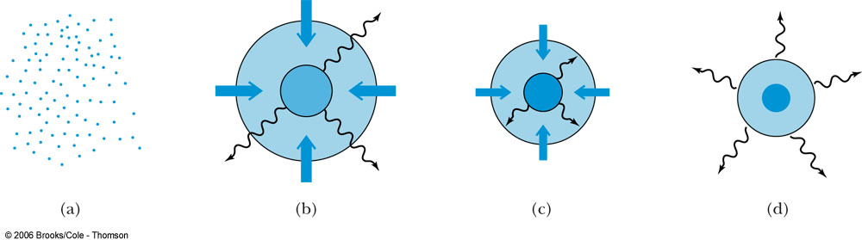
The Birth of Stars
As the universe cooled, gravitational forces attracted the matter into gaseous clouds, which formed the basis of stars.
This process continued as the interior temperature and density of these clouds increased.
Nuclear fusion began when the temperature reached 10⁷ K.
Initially, fusion created helium from the hydrogen nuclei. Then further processes created carbon and heavier elements up to iron.

Slide 16
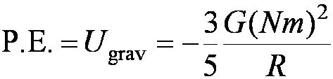
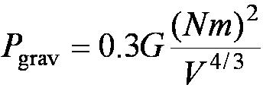
The Fate of Stars
The final stages of a star occur when the hydrogen fuel is exhausted and helium fuses. Heavier elements are then created until the process reaches the iron region.
At this point the elements in the star have the highest binding energy per nucleon and the fusion reactions end.
For N nucleons each of mass m, the potential energy of a sphere of mass Nm and radius R is
The gravitational pressure is

Slide 17

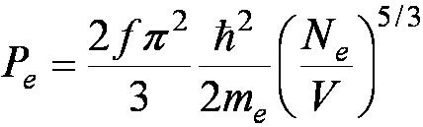
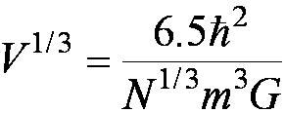
The Fate of Stars
Matter is kept from total collapse by the outward electron pressure due to the Pauli exclusion principle. For massive stars, the gravity will force the electrons to interact with the protons:
This result is called a neutron star from the abundance of neutrons. Similarly, the neutrons have an outward pressure:
Balancing these pressures yields the volume of a neutron star:

Slide 18
16.4: Astronomical Objects
Galaxies
Galaxies are collections of stars bound by gravitational attraction.
Our galaxy is the Milky Way with 200 billion stars.
The total number of galaxies in the universe is about 100 billion.
Andromeda is the closest galaxy within a million lightyears.
Quasars
Quasars are quasi-star objects with tremendously strong radio signals and strange optical spectra.
They can outshine galaxies.
They are among the most distant and oldest objects in the universe.
They must evolve into objects that are common today.

Slide 19
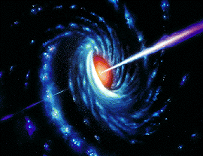
Active Galactic Nuclei (AGN)
Active galactic nuclei is a category of exotic objects that includes: luminous quasars, Seyfert galaxies, and blazars.
Many believe the core of an AGN contains a supermassive black hole surrounded by an accretion disk. As matter spirals in the black hole, electromagnetic radiation and plasma jets spew outward from the poles.
Blazars are AGN with jets spewing relativistic energies toward the Earth.

Slide 20
Gamma Ray Astrophysics
Gamma-ray bursts (GRBs) are short flashes of electromagnetic radiation that are observed about once a day at unpredictable times from random directions.
GRBs are absorbed in the atmosphere so they are observed by satellites.
They last from a few milliseconds to several minutes.
They were recently discovered to come from supernovae in distant galaxies.
An interesting property of GRBs is the afterglow of lower energy photons including x rays, light and radio waves that last for weeks.
The optical spectra of the GRBs is nearly identical to the jet of a supernova.

Slide 21
Novae and Supernovae
Novae and supernovae are stars that brighten and then fade.
Type I supernovae have no hydrogen spectral lines and type II do.
Type Ia are the brightest and are thought to be collapsing white dwarf stars.
Cataclysmic explosions in supernovae provide the temperature and pressure to produce heavier elements such as uranium.
The Crab supernova occurred in 1054 and was recorded by the Chinese and Japanese. It was bright enough to see during the daytime.
Other supernovae occurred in 1572, 1604 and 1987.

Slide 22
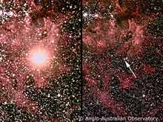
Supernova Explosion
SN 1987A Supernova
As most of the heavier elements fused
into iron, the iron nuclei became so hot
that they spewed out helium nuclei.
The temperature and density were large
enough to radiate neutrinos.
The gravitational force was strong enough to form a neutron star.
The implosion rebounded from the repulsive strong nuclear force in the core and created a dense shockwave. The shockwave radiated neutrinos out from the star.
These neutrinos were detected in Japan and the U.S. three hours before the light reached the Earth.
The neutrino observations were consistent with the supernova predictions.
after before

Slide 23
16.5: Problems with the Big Bang
Why is the universe flat? Depending on the mass density of the universe, parallel lines eventually converge. This is called the critical density.
  A mass density less than the critical density causes parallel lines to diverge. This is an open universe.
  For a mass density greater than the critical density, parallel lines converge. This is a closed universe.
  A flat universe has a critical mass density and parallel lines remain parallel.
Why does the universe appear to be homogeneous and isotropic? This is called the horizon problem. It is curious that opposite sides of the universe that are 27 billion lightyears apart have the same microwave background in every direction.
Why have we never detected magnetic monopoles? Magnetic monopoles would bring symmetry to many theories in physics.

Slide 24
The Inflationary Universe
A variation of the Big Bang model proposes that the universe suddenly expanded by a factor of 10⁵⁰ during the time 10⁻³⁵ to 10⁻³¹ seconds after the Big Bang. This is called the inflationary epoch. It is due to the separation of the nuclear and electroweak forces.
After the inflationary period, it resumed its evolution from the Big Bang.
The inflationary theory requires that the mass density be near the critical density.
The universe reached equilibrium before the inflationary period began. This explains the homogeneous universe.
Magnetic monopoles would have to occur along the boundaries or walls of different domains.

Slide 25
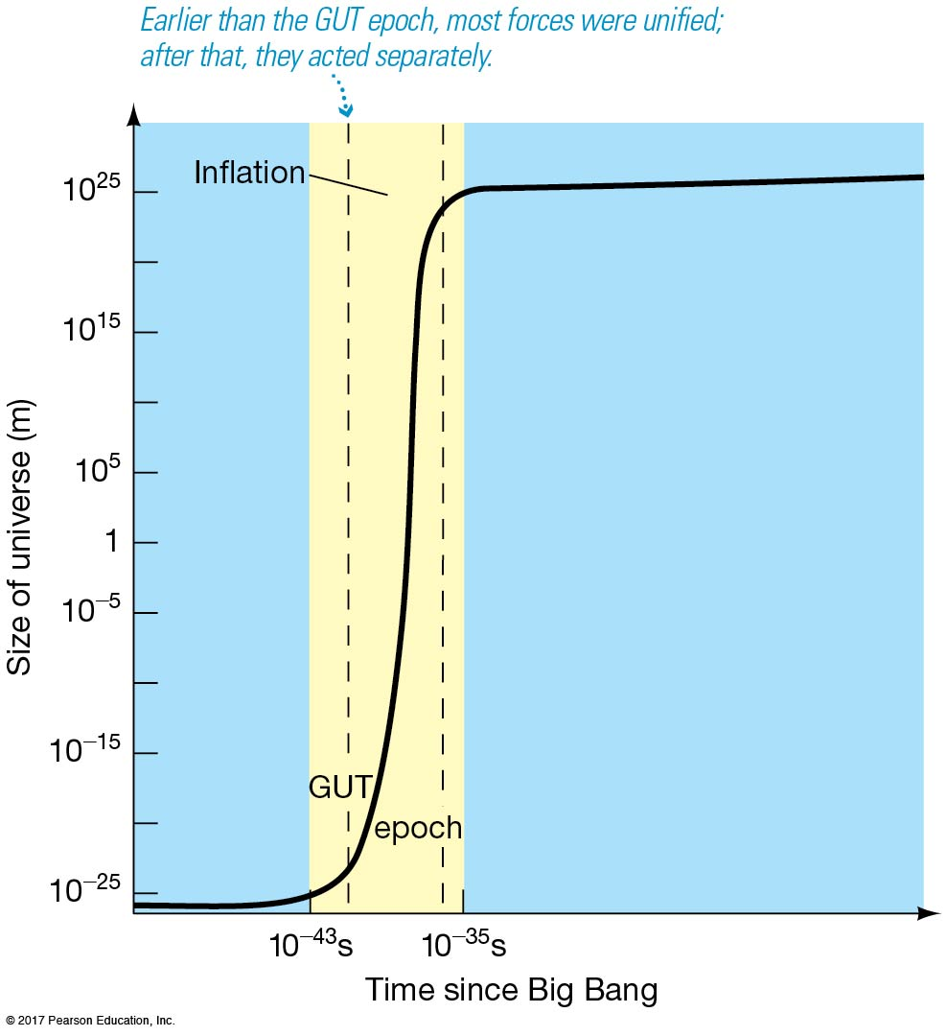

Slide 26
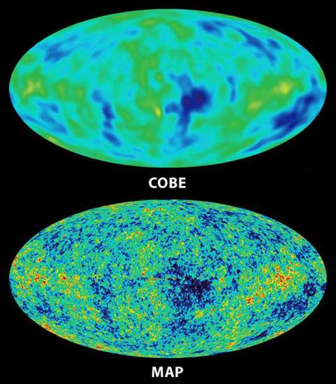
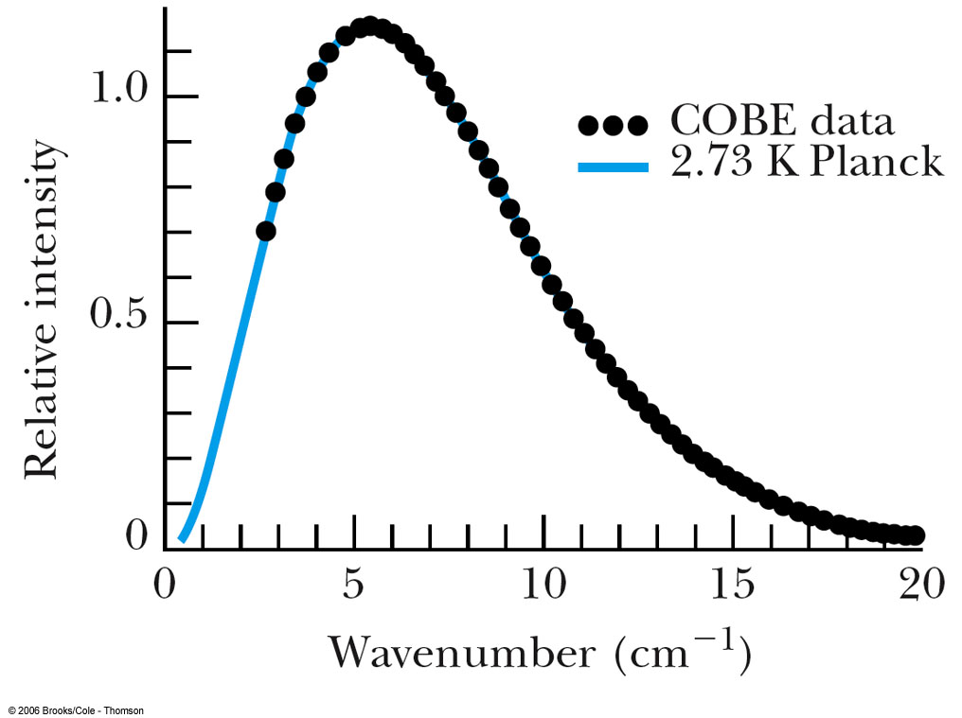
The Lingering Problems
1) Formation of Stars & Galaxies
The universe is clumpy. The distribution of stars and galaxies is not uniform.
The cosmic background radiation has fluctuations that may have led to galaxy formation.
2) How Can Stars Be Older Than the Universe?
Observations indicated that the universe was 14 billion years old or younger while some stars appeared to be 15 billion years old or older. Astronomers concluded that the age of the stars was incorrect. This was resolved by considering an accelerating universe.
The repulsive force causing the acceleration is called dark energy.

Slide 27
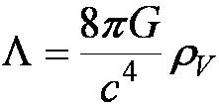
The Lingering Problems
3) Dark Matter
Observations show a discrepancy between the mass of the universe required for critical density and the apparent mass density. This is known as the missing mass problem. It is resolved by considering unseen mass in the universe called dark matter.
Another theory resolves the missing mass problem by modifying Newton’s laws at large distances instead of considering dark matter.
4) The Accelerating Universe
Supernovae data suggested that the expansion of the universe is speeding up. This acceleration requires that dark energy is 75% of the mass-energy in the universe.
Many theorists think that dark energy can be explained
with Einstein’s cosmological constant.
Dark energy seems to have become effective 5-10 billion years ago.
Dark energy can be generalized to quintessence, which is a dynamic time-evolving spatially-changing form of energy that could have negative pressure.
Another explanation of dark energy to a cosmic field associated with inflation.
The problem could also be with general relativity itself.

Slide 28
16.6: The Age of the Universe
Current observations show the universe to be 13.7 ± 0.2 billion years old.
Using radioactive decay of certain elements, some meteorites hitting the Earth are 4.5 billion years old and various techniques suggest that the universe is between 8 to 17.5 billion years old.
Radioactive dating of stars showed that stars were formed as early as 200,000 years after the Big Bang.
Examining the relative intensities of elemental spectral lines of old stars shows that the ratios of thorium/europium and uranium/thorium isotopes indicate an average age of 14 billion years.

Slide 29
Age of Astronomical Objects
Globular clusters are aggregations containing up to millions of stars that are gravitationally bound. Thousands of stars in each cluster are about the same age. Using an H-R diagram that compares the temperature and the luminosity of stars shows that the age of a star is inversely proportional to the luminosity. Thus an upper limit on the age of the cluster can be determined from the most luminous star.
These clusters are about 11 to 13 billion years old.
Stars the size of our sun become white dwarfs after burning all their fuel. White dwarfs produce residual heat radiation similar to smoldering coals from an old campfire. They appear to be 12 to 13 billion years old.

Slide 30



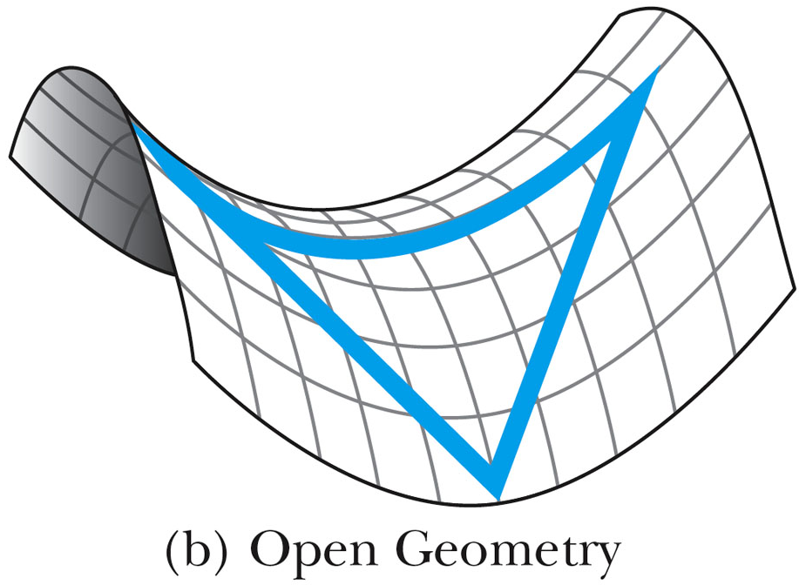
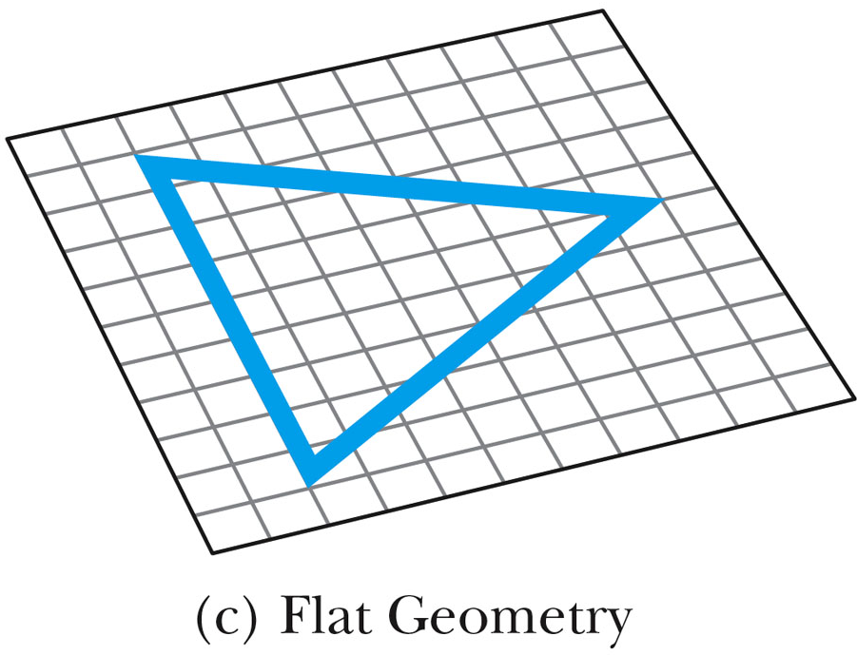
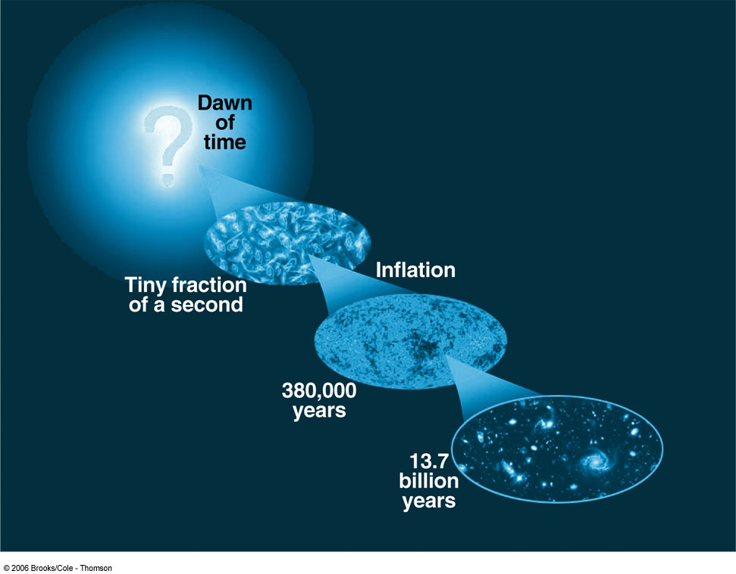
Cosmological Determinations
To determine the theoretical age of the universe consider again the equation:
rewritten as
The second term depends on the curvature of the universe, which depends on the geometry of spacetime. There are three classes of curvature, each dependent on the parameter k. If the curvature term is greater than 1, it is a closed geometry similar to a sphere. If it is less than 1, the universe has a hyperbolic geometry. Equal to 1 yields a flat universe.
Inflationary theory indicates the universe should have a flat geometry or zero curvature.
The Wilkinson Microwave Anisotropy Probe determined that the universe is flat to within 2% margin of error by analyzing fluctuations in the cosmic microwave background radiation.
Astronomers also found that the Hubble constant is 71 ± 4 km/s/Mpc and found that the universe is 13.7 billion years old using: τ = 1 / H₀.

Slide 31
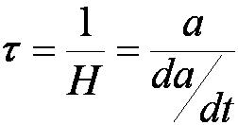
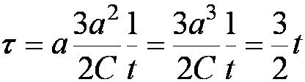
Cosmological Determinations
The Sloan Digital Sky Survey is a project to map in detail one quarter of the entire sky and to determine the position and brightness of more than 100 million astronomical objects. It will also measure distances of more than a million galaxies and quasars. Data from 3000 quasars was used to date the cosmic clustering of hydrogen gas. This data suggests that the universe is 13.6 billion years old.
A method of determining the future of the universe uses the scale factor a, which is the approximate galactic separation distance. The Hubble time is
In the case of a flat universe we have:
where τ = (H₀)⁻¹ = 13.7 billion years, meaning that the universe is 9 billion years old. This calculation overestimates the total mass of the universe. Further refinement shows t = τ = (H₀)⁻¹ = 13.7 billion years.

Slide 32
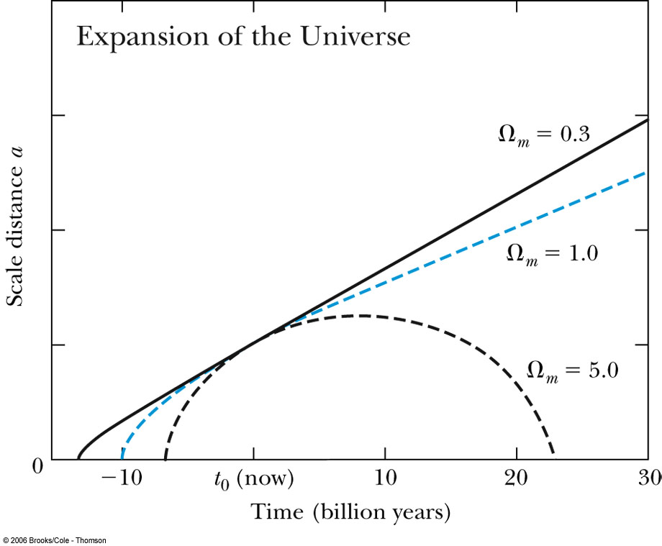
Universe Age Conclusion
There is little question that the results are coalescing around 14 billion years for the age of the universe.
Some results indicate a more precise value of 13.7 billion years.

Slide 33
16.7: The Future
The Demise of the Sun
The sun is about halfway through its life as a star which started 4.5 billion years ago. As the hydrogen fuel is exhausted, the sun will contract and heat up more while burning helium.
The heat will cause the outside layers to expand and consume the Earth.
The sun will become a red giant and the surface will cool from 5500 K to 4000 K.
Eventually the light elements in the outer layers will boil off and the sun will contract to the size of the Earth with a final mass that will be half its current mass.
The sun will cool down to become a white dwarf and then a cold black dwarf.

Slide 34
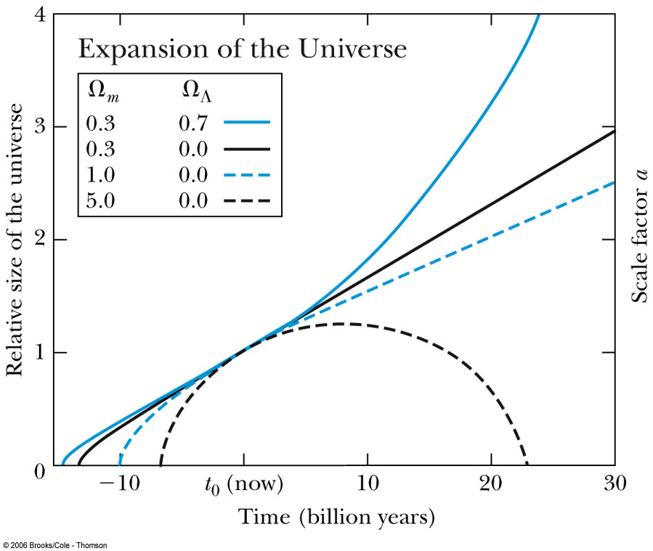
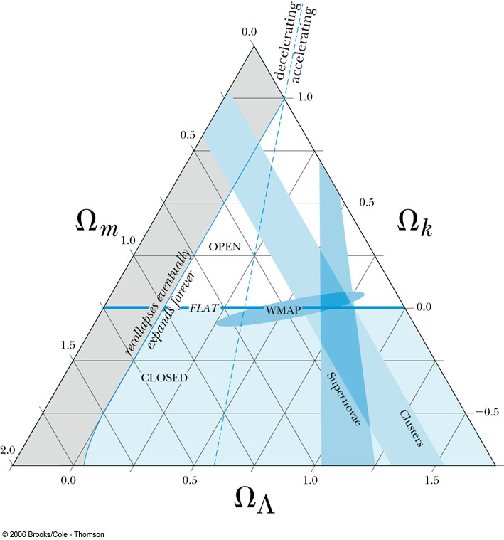
Where Is the Missing Mass?
Visible matter is only 4% of the total mass in the universe. Dark matter accounts for 23% and 73% is dark energy.
The size of the universe is expanding and even accelerating its expansion.
These results are represented in a cosmic triangle. Constraints from three sets of data are included. The type Ia supernovae data are consistent with an accelerating universe while the cosmic microwave background radiation is consistent with a flat universe. The star cluster and galaxy data is consistent with a low density universe. The intersection of these sets of data constrains the universe mass parameters to the values: Ω_{k} = 0, Ω_{m} = 0.3, and Ω_{Λ} = 0.7.

Slide 35
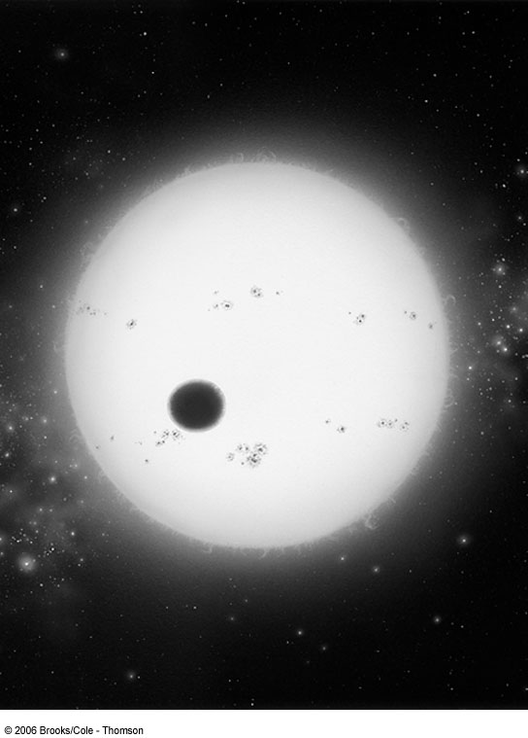
The Future of the Universe
The universe is flat, but it is expanding. The expansion is accelerating.
Eventually all the stars in our galaxy will die as well as in all other galaxies. Black holes will not be able to find any more mass to consume.
The laws of thermodynamics indicate the universe will be a cold, dark place.
Are Other Earths Out There?
There are many candidates for extrasolar planets.
These were identified through observations of a wobbling star. The wobble’s period and magnitude indicates the planet’s orbit and minimum mass.
Observations of dust swirling around a star indicates a planet is forming.
Small burnt-out stars called brown dwarfs are sometimes confused with planets.

